Slide 1
Gender Responsive Budgeting HARRY GWALA DISTRICT MUNICIPALITY WOMENS CAUCUS STRATEGIC PLANNING SESSION 17 March 2021
Financial Fiscal Commission

Slide 2
Presentation outline
Role and function of the FFC
What is gender budgeting?
Why GRB is important?
What are key aspects of GRB?
Harry Gwala District Municipality (HG DM) Budget and GRB-A critique
Recommendations

Slide 3
Role and Function of the FFC
The Financial and Fiscal Commission (FFC)
Is an independent, permanent, statutory institution established in terms of Section 220 of the Constitution
Must function in terms of the FFC Act
Mandate of Commission
To make recommendations, envisaged in Chapter 13 of the Constitution or in national legislation to Parliament, Provincial Legislatures, and any other organ of state determined by national legislation
The Commission’s focus is primarily on the equitable division of nationally collected revenue among the three spheres of government and any other financial and fiscal matters
Legislative provisions or executive decisions that affect either provincial or local government from a financial and/or fiscal perspective
Includes regulations associated with legislation that may amend or extend such legislation
Commission must be consulted in terms of the FFC Act

Slide 4
What is gender budgeting?
Gender equality is a fundamental human right. This principle is found in the Constitution -Bill of Rights. Its fundamental also for achieving SDG 2030, AU Agenda 263, SADC protocols, ILO conventions (non-discrimination, equal pay) which South Africa has ratified, and reaffirmed in the NDP and the Employment Equity Act
Despite these commitments, unacceptable gender inequalities remain in South Africa. These gender commitments should be translated into fiscal commitments at local level.
The budget is one of the essential tools to achieve gender equality and gender equity. This use of the budget to achieve gender equality/equity is called Gender Responsive Budgeting (GRB). It is preceded by planning and followed by implementation, monitoring and evaluation.
GRB is about deliberately making the Intergovernmental fiscal relation system sensitive/responsive to the needs of women and contributing to moving women out of poverty
It is about gender-sensitive resource allocation
Integrating a clear gender perspective within the overall context of the budget process
Understanding the implications of fiscal decisions on gender
Budget prioritization based on needs of men and women- ensuring inclusivity
Gender budgeting is an innovative strategy for achieving gender equality
It is NOT a new budget or separate budget for women but rather the integration of gender approaches into all stages of the budget cycle (mainstreaming)

Slide 5
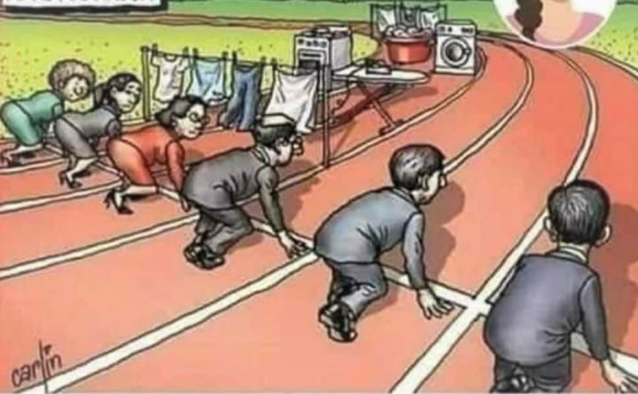

Why GRB is important?
What gender responsive budgeting can do? (One of the blocks
The struggles and obstacles to women reaching their goals

Slide 6
Why GRB is important?
In the SA context poverty, inequality and unemployment, are largely gendered. 52% of females are poor and 74,8% of female-headed households in rural areas are poor.
Women, despite being the majority in rural South Africa, own only 13% of farms and agricultural land, while men own 71%.
Additionally, we must consider that when income is placed in the hands of women, research shows that they spend 70% of it on the family. As opposed to men, who spend only 30% of their income on families.
Objective of building resilient, vibrant, sustainable communities can best be met by empowering women.
Empowering women through the budget is not only the right thing to do, but we cannot win on anything if “half team is not playing”.
Gender non-sensitive budgets are inefficient and do not accord with the principles of equality enshrined in the Constitution.
A successful IGFR system is one that is sensitive to the needs of women and contributes to empowering women and moving them out of poverty.

Slide 7
Highlights of FFC Research on GRB: A Reminder
Findings
Lack of Gender Mainstreaming and Women Empowerment as an approach
Lack of gender disaggregated data
Equity versus mainstreaming for gender equality: More about the numbers
Weak translation of gender equality commitments into fiscal commitments: IDPs show little evidence of the way the IDP planning processes and budget offices have budgeted for gender mainstreaming
Gender discourse is events driven
Lack of gender budgeting training and capacity building of decision makers
Poor Institutionalising of gender responsive budgeting
Absence of analysis of the gender impact of existing revenues and expenditures
Absence of an approved gender policy across all municipalities
Absence of a municipal gender mainstreaming strategy
Personnel in management (who make decisions) and budget officers (who track expenditure) have limited knowledge of gender mainstreaming
Gender equality indicators and the collection of gender disaggregated information is limited

Slide 8
Highlights of FFC Research
Recommendations
The governments should:
Run gender budgeting pilots in a few municipalities first and evaluate results for impact before wider application.
Ensure municipal integrated development plans institutionalise gender planning by sector (e.g., water and sanitation, local economic development etc.) and include gender disaggregated performance indicators and targets; provide gender budgeting good practice guides and toolkits.
Provide guidelines for collecting gender-disaggregated data for budgeting processes and ensure that municipalities have the capacity to analyse budgets from a gender perspective.
Institutionalise gender-responsive budgeting process linked to integrated development plans.
Build capacity for gender mainstreaming and gender responsive budgeting at local level.
Ensure gender-responsive appropriations and budget allocations and
Ensure gender-sensitive public participation and consultations at local level

Slide 9
What are key aspects of GRB?
1
Planning
IDPs and other planning instruments: From IDP consultation, situational analysis, gender diagnosis backed by gender disaggregated data, to projects identified - should be inclusive and respond to women needs. If gender issues are not planned, no budgeting or implementation of GRB will take place
2
Call for budget circulars
Budget circulars give guidelines of what budgets must contain. Gender issues are raised there - that budget must be responsive to gender issues
3
Budget processes
Consultation and participatory budgeting process, Principles, Assumptions, resource allocations., Monitoring, evaluation-gender impact assessment

Slide 10
Harry Gwala District Municipality (HG DM) Budget and GRB-A critique

Slide 11
Strengths/Opportunities to Engender budgets
IDP informs the budget. The crafting of the IDP should be consultative and participatory. HG DM excels in this. It consults a variety of stakeholders; from business, to churches, to CSOs. It endeavours to leave no one behind.
Contracted services- in 2020/21 HG DM will spend R118 million on contracted services. Although savings are being realised here, there is opportunity to engender budget through procurement.
Catering services and outsourcing is being discouraged and reduced. But where it takes place, it should provide an opportunity for making procurement inclusive, if its well targeted
The District continues to make good progress with the eradication of backlogs - this is known to have positive implications on women.
The IDP should ideally capture the spirit, objectives and intentions of the National Policy Framework for Women’s Empowerment and Gender Equality (2000). It tries to foster a conductive environment for gender mainstreaming within state institutions and municipalities through the creation of the necessary internal policies, legislative and administrative frameworks, which address the need for gender equality. The alignment of the IDP and the National Policy Framework for Women’s Empowerment and Gender Equality (2000), needs strengthening.

Slide 12
Where there are Gaps! Gender indicators
To adequately inform a gender sensitive budget the IDP should have gender sensitive indicators. This is narrowly done. It needs to be comprehensive in the IDP.
Gender indicators include:
Incorporate gender-disaggregated information, separate measures for men and women on a specific variable such as literacy (% of women vs. % of men being literate)
Gender Based Violence indicators (number of women abused)
Women in unpaid care work (as they give attention to gender power relations at household and societal levels)
Justice: are women and the vulnerable protected by the rule of law?
Health: maternal mortality and infant mortality rates
Gender disaggregated data on consumption and expenditure within the household (for gender power relations)
Gender gaps in earnings in wage and self-employment
Land ownership and house title, by gender
These indicators are essential to inform oversight bodies on progress towards reducing vulnerability and inequality and where there is need to deploy resources

Slide 13
Strengths/Opportunities to Engender budgets
The budget document lists the municipality IDP’s five strategic objectives for the 2020/21 MTREF which informed the budget. In these objectives it is important to infuse gender issues. For example, IDP strategic objective 5 “Fight poverty and build clean, healthy, safe and sustainable communities” - there is a need to ensure gender specific programmes that will be budgeted for. It must be clear how gender equality programmes will be incorporated in the strategy, also how it will be funded.
Under Operations department there is a special programme which includes programmes for the elderly, youth disabled, HIV/AIDs and cultural services. Perhaps in this programme gender mainstreaming can be included, as it is not explicit - this sub-programme if well-resourced can play a critical role in addressing gender equality in a more integrated and sustainable way. There is also under Operations department, a sub-function called youth development. Perhaps all these vulnerable groups could be included in one sub- programme, however collecting disaggregated data should be norm so as to measure separately the impact on each group.
The Harry Gwala District Municipality has allocated R17m towards LED projects in 2020/21. This is commendable, as LED is one of the indicators used to assess GRB budgets and is known to alleviate the plight of women. However, to effectively address GRB, disaggregation of the data towards LED programme/project is needed to show how by gender, people are benefiting from the programme.

Slide 14
Where there are Gaps!
Budget Steering Committee is key in providing technical assistance to the Mayor in discharging the responsibilities set out in section 53 of the Act. It’s a key structure in budgeting. If this structure is not capacitated on gender, then it becomes difficult to have gender responsive budgets. Budget Steering Committee needs to be capacitated with the skills to draft gender sensitive budgets.
Harry Gwala District Municipality completed a data cleansing exercise to review its Indigent Policy. This data on should be gender disaggregated, among other variables, if it is not already - to understand who is being targeted and impacted by policy.
Budget principles/assumptions that inform the budget need to articulate and mainstream gender imperatives and presently they do not. In principle MTERF should indicate that the budget will be Gender Responsive and monitoring indicators/mechanisms for this should be put in place
Where possible rates, tariffs and other charges/exemptions when adjusted should be gender sensitive, especially on services that women spend more money on and when protecting indigent households, mainly women. Women spend 33% of their income on basic services, while men spend about 32%. Need also to assess gender impact of changes in tariffs.
Spending on R&M is crucial. Women tend to carry a disproportionate burden of living with decaying essential basic infrastructure - water and sanitation infrastructure. Women spend 33% on basic services (men 32%). HG DM still lags behind the norm of 8% of Opex in terms of R&M – Over MTREF R&M will average 4%

Slide 15
Harry Gwala Budget and GRB-A critique?
Budget needs to protect basic services- infrastructure budgets and social services- Women are disproportionately affected by weak or poor infrastructure investments

Slide 16
Recommendations?
Successful GRB requires political support and leadership.
Budget Steering Committee should play a stronger leadership role in institutionalising gender budgets and preparing budgets through a gender lens. Committees such as the MPAC have a crucial role in scrutinising budgets for their gender sensitivity.
GRB should be anchored in a legal framework to strengthen the process. After every budget statement, is it possible for Council to answer to the Question: What are the gender implications of the budget?
Gender-aware data is necessary from the IDP itself as the IDP informs the budget. There is a need to invest in data collection and research.
Making budget preparation consultative/participatory/inclusive and including CSOs and vulnerable/marginalised groups is a good practice.
Build gender capacity within the Budget Steering Committee, technical, financial, M&E staff in budget office, but also for women and men elected in representative bodies (council and committees)

Slide 17
To Councillors Specifically
Look at the policies of different departments to analyse how they increase or decrease inequalities between women and men and other vulnerable members of society
Look at total revenue collection and who (based on gender, whether corporates or individuals) is contributing - as well as how regressive or unfair the overall rates/levy system might be.
Look at whether the budget (revenue and spending) takes into account the way in which time is spent by men and women and others in households – which means that unpaid work gets included. The Budget should not make women spend more time looking for water! In Morocco municipalities facilitate/subsidise the construction of kindergarten centers as this helps women spend more time in the labour market and girl children to do more schoolwork.
Ensure that government economic planning documents include gender specific analyses, and that the budget statement is gender sensitive.
Political commitment and leadership at the highest level of government to making budgets work for gender justice.
Ensure that there are gender champions within council and at every department.
Ensure that key players, including Mayors, officials, Councilors and civil society have sufficient awareness and capacity to deliver GRB.
Ensure that Gender-disaggregated statistics and other data are available.

Slide 18
Thankyou

Slide 19
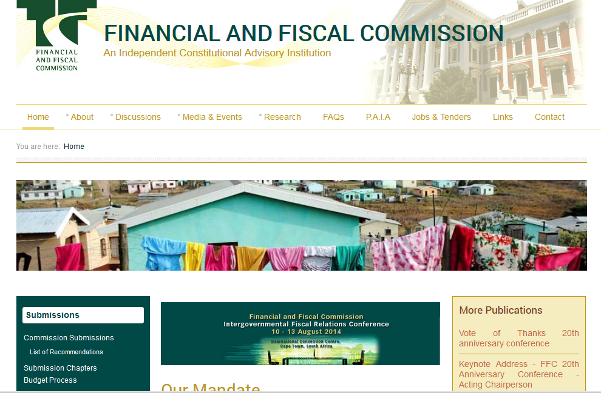
FFC’s Website: www.ffc.co.za
FFC MTBPS Training for SCoA_September 2014
Introduction to the Financial and Fiscal Commission 2014

